Slide 1



PRESENTATION
OF CHANGING AN ER DIAGRAM INTO RELATION MODEL

Slide 2
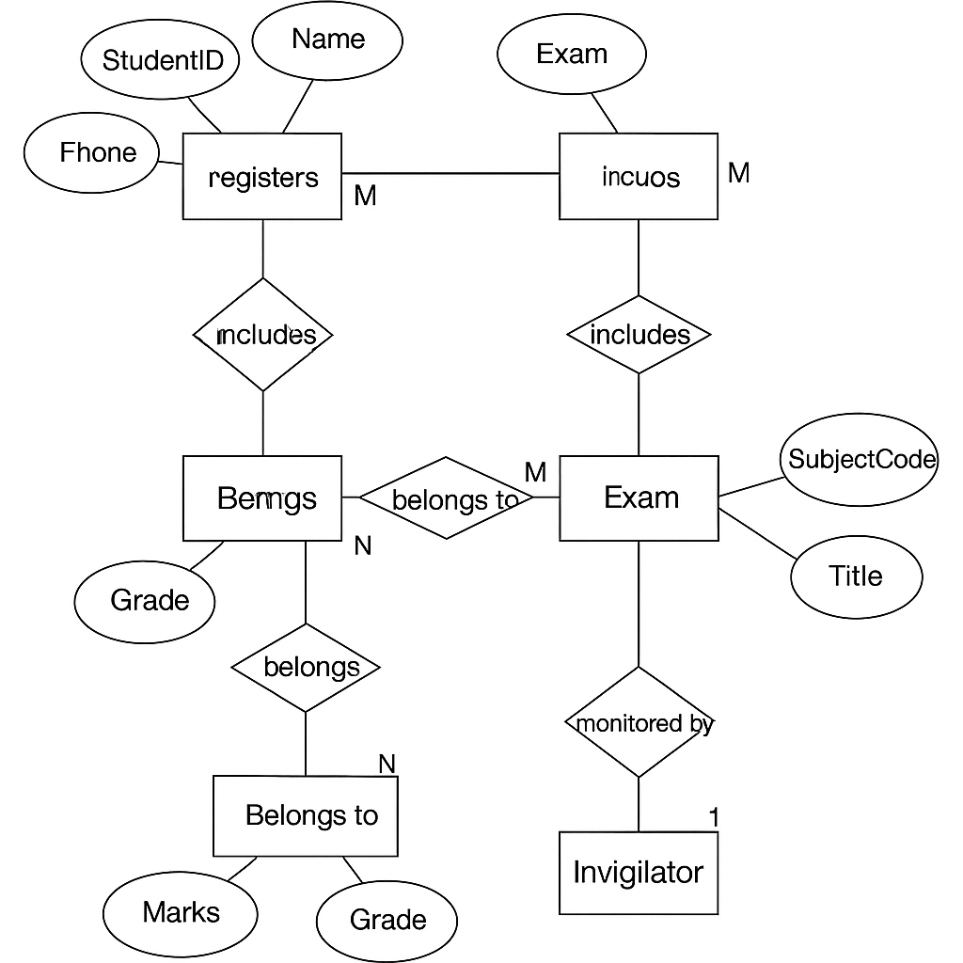

-ID
EXAM
Er diagram of Student Exam Management System
RESULT
MARKS

Slide 3
Conversion of Er diagram into relational model
📦 Entity / Relationship | 📑 Relational Table & Attributes | 🔐 Primary Key (PK) / 🔗 Foreign Key (FK)
Student | Student(StudentID (PK), FirstName, LastName, DOB, Age) | PK: StudentID
Multivalued Attribute (Phone) | StudentPhone(StudentID (FK), Phone) | Composite PK: StudentID + Phone
Exam | Exam(ExamID (PK), Date, InvigilatorID (FK)) | PK: ExamID, FK: InvigilatorID
Subject | Subject(SubjectCode (PK), Title) | PK: SubjectCode
Invigilator | Invigilator(InvigilatorID (PK), Name) | PK: InvigilatorID
Student-Exam Relationship (registers) | Register(StudentID (FK), ExamID (FK)) | Composite PK: StudentID + ExamID
Exam-Subject Relationship (includes) | ExamSubject(ExamID (FK), SubjectCode (FK)) | Composite PK: ExamID + SubjectCode
Weak Entity: Result | Result(StudentID (FK), ExamID (FK), Marks, Grade) | Composite PK: StudentID + ExamID

Slide 4
THANK YOU

